Slide 1
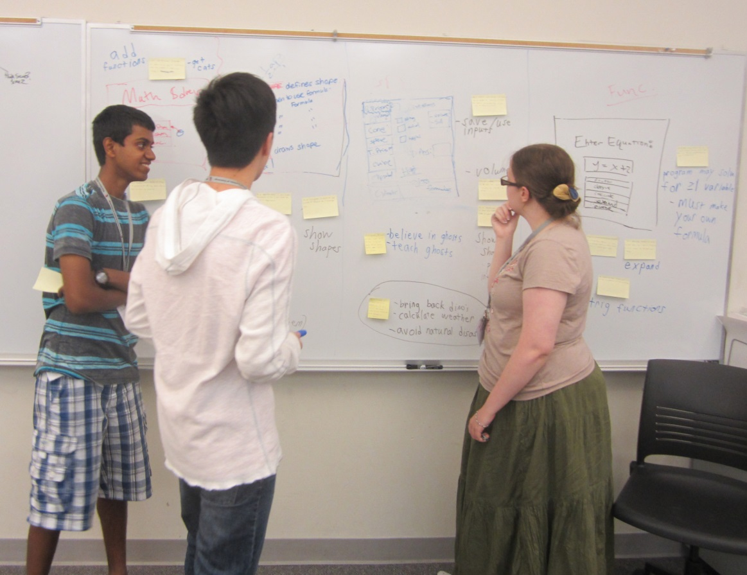
Operation Catapult Python Programming Projects – Day 1
Welcome!
Left – A past Catapult team in action. They built a system to help solve high-school geometry problems. On the way, the team invented a new design tool, seen on the board here, which combines story boards and user stories (the Post-its on the pictures).

Slide 2
Turn on machines now
Raspberry Pis are not to leave the room
Use only for projects
Who has a laptop they want to use?
Please bring them tomorrow
We’ll help you install the software

Slide 3
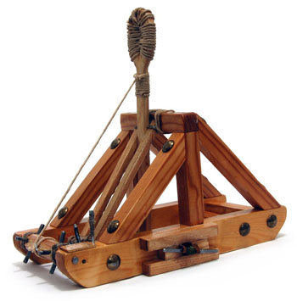
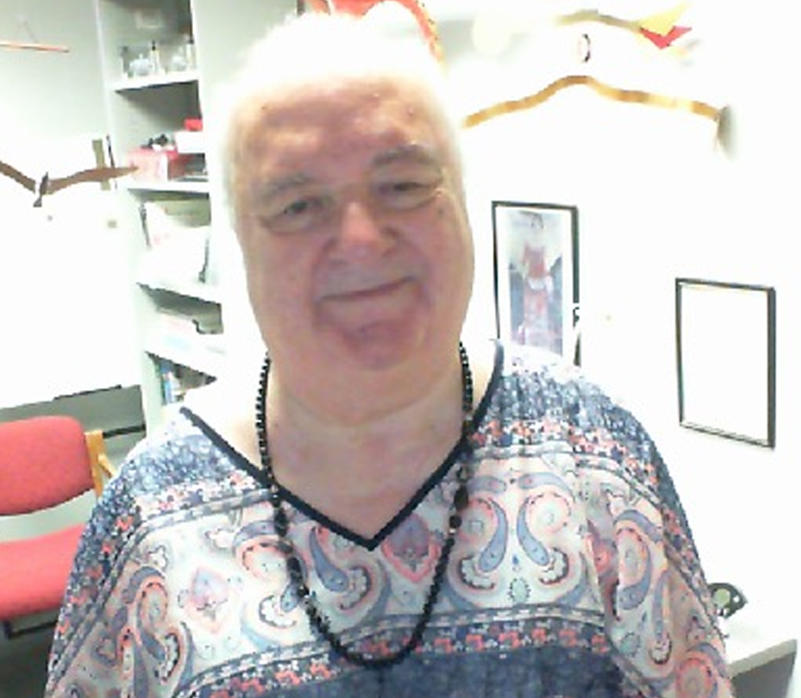
Your teaching team
Dr. Steve Chenoweth
Associate Professor CSSE
chenowet@rose-hulman.edu
Office @ Monech Hall, D215B
Derek Grayless
Programming Student Assistant
CSSE
grayledw@rose-hulman.edu
Anthony Galea
Programming Student Assistant
CSSE
galeaac@rose-hulman.edu

Slide 4

Get to know each other
We will be in this room for 70+ hours over 3 weeks.
Name, hometown, and something interesting or unusual about yourself.
Why did you pick this project? What you hope to learn/do?
If you have programming experience, tell us about it.

Slide 5
Website
Go to: https://www.rose-hulman.edu/class/csse/catapult/
Take 5 mins to explore what’s there
If you have a laptop, the assistant will help you start to install the software.

Slide 6
Overall Plan 1/2
For the first 5 days
Instruction in the classroom aimed at those with no programming background
Work in the lab on programs that we assign
Start thinking about projects

Slide 7

Overall Plan 2/2
Monday (or so)
Finalize groups and projects
After that
Work on your group’s project
Get help from your instructors and assistants
There will be occasional “all together” classroom time

Slide 8
Computer Programming with Python
A lot of fun. You should have a great sense of accomplishment by the end.
A lot of learning. About programming, about Python, about using pre-defined packages to handle many of the details.
A lot of work. Some of the things you will accomplish will not come easily. But you’ll feel great when you have done them!

Slide 9
Learning and Doing
Learning Python:
Repeat…
Discussion time, followed by time for you to learn by writing small programs
…until you have mastered the basic concepts
Everyone will be doing the same small programs. Students with more programming experience may want to add extra features or they may want to work ahead
After that, groups will choose and work on their specific projects

Slide 10
Maximize your learning
Do
Don’t
Your share of the driving
Ask questions
Ask for help when you are stuck
Help others around you or try new things if you are experienced
Let your partner take over
Think you are the only one who is confused
Try to figure it all out alone
Sit idle while waiting for others

Slide 11
Class Discussion-Time Etiquette
Goal: learn Python quickly, so can get to projects
Do ask me questions at any time
Do interact with your neighbors about the things we are discussing, exercises you are doing. Always think, whether typing or observing!
Don’t do things that will distract us from the learning process such as …
IM, email, …
using the speakers on your computer or other audio device.

Slide 12
Lab Etiquette
Project time is time to focus on your project
not the time to surf the web or send email or texts
If a partner begins to get “off track”, a reminder from you may help
We will take breaks
Let’s speak to each other kindly, and only with words that our mothers would not be embarrassed to hear us say
Be very careful with drink in the labs
If you need to use the bathroom, get a drink of water, etc., it is not necessary to ask first

Slide 13
What if you already know something (or lots!) about programming?
You’ll still probably learn some new and important things in the next couple of days
If you find a concept or assignment to be easy, please put that to good use by patiently helping others around you to understand it
And think of “extra” features to add to the assigned programs

Slide 14
Algorithms, Languages, Translators
What is an algorithm?
How do we communicate an algorithm to another person?
Depends on the person. Has to be in a language they can understand.
Baking a cake. Telling my mother vs. telling my 5-year old son.

Slide 15
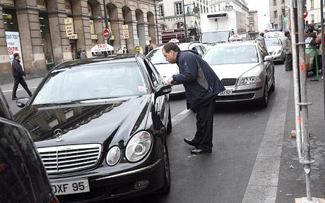
Language Barriers
What if we want to have Pierre perform an algorithm for us, but we do not know his language?
We could hire a translator (a.k.a. compiler) to translate all of the instructions into French, and give them to Pierre.
We could instead hire an interpreter. We read the next instruction to be done, the interpreter translates it into French, and Pierre does it.
In the first case, it takes longer before Pierre can get started; in the second case, execution of each instruction is a little bit slower.
Python is more like that interpreter.
You: Can you take me to the Eiffel tower?
Pierre: Eh?

Slide 16
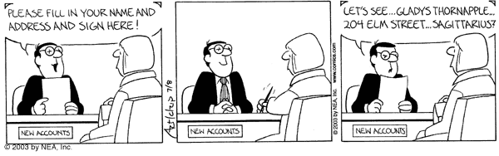
Understanding terminology and using it properly can enhance communication
Some important terms you will learn:
function
argument
parameter
string
list
class
method

Slide 17
Experimenting with the person next to you – a fun exercise!
Take a card
Find something to write with
Number off – 1, 2, 1, 2, 1, 2, 1, 2, …
Without looking at what anyone else is doing…
If you are a “1”, write down any problem!
If you are a “2”, write down any solution!
Then…

Slide 18
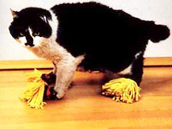
The experiment, continued…
Pair up with someone next to you who is the other number
Find some harebrained way to make the solution solve the problem!
Let’s hear about some of the interesting problems and solutions!!!
Notes:
May be a five minutes break at this point.

Slide 19

Python 1/2
Invented in 1990 by Guido van Rossum.
Named for “Monty Python’s Flying Circus”
Now has a huge worldwide following.

Slide 20
Python 2/2
Makes it simple to do simple things.
Has the power to do complex things.
We think you will like it!
“Official” web site is python.org .
Also links on our website

Slide 21
Other Resources
See resources linked to from our website
Python Tutorials
https://docs.python.org/3/tutorial/
Python Programming E-Books
Go to https://www.rose-hulman.edu/academics/learning-and-research-facilities/logan-library/index.html
Click the + sign. Then, under Catalog
Use “Python Programming” as the search term
Select a book that you like, log in, and download the pdf

Slide 22
I have no idea what you are talking about!
If I go too fast, or for any other reason you are not getting it, don’t let me go on.
Stop me, ask a question!
During demo times, if you are stuck, raise your hand and we will come to help you.

Slide 23
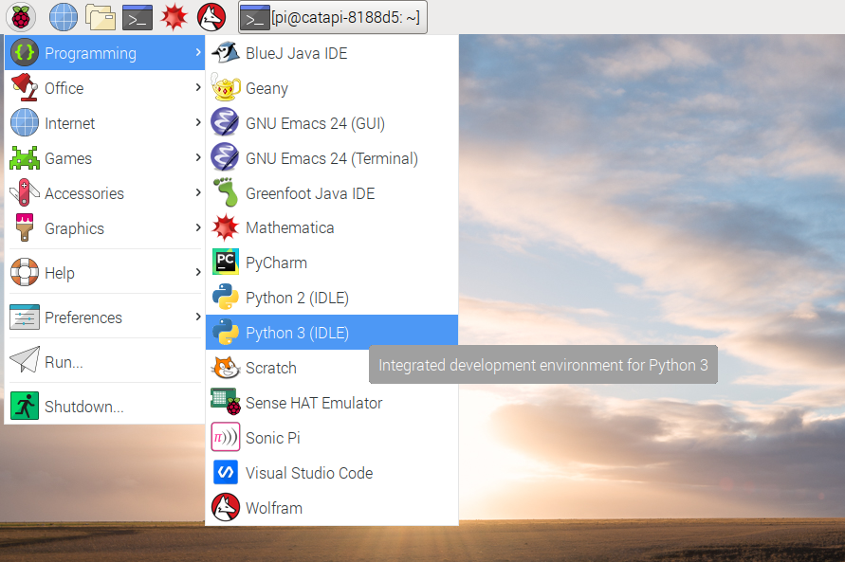
Python Demo
Open up the IDLE program from the RaspberryPi and follow along
Notes:
Demo tic tac toe and circle programs.
Variables, calculations. If time allows, do loops and strings.
See transcript

Slide 24
Python Demo
Ask questions as they come up
If your questions are “advanced programming” questions, I may defer the answer so as not to confuse the beginning programmers
Demo of some Python features
Enjoy the ride
I will post most everything I show you to the website
You’ll use many of these features tomorrow
Notes:
Demo tic tac toe and circle programs.
Variables, calculations. If time allows, do loops and strings.
See transcript

Slide 25
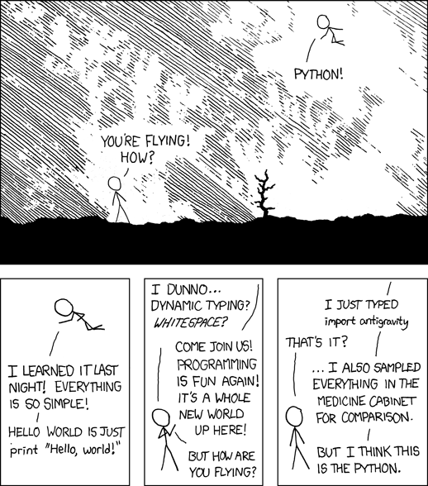
http://xkcd.com/353/
Notes:
Demo tic tac toe and circle programs.
Variables, calculations. If time allows, do loops and strings.
See transcript

Slide 26
Do the Catapult Surveys before you go
On Moodle

